Slide 1
ISE 365/465 –Applied Data Mining – Overview, Ch 1. and 4.1-2
Mike Magent
Industrial and Systems Engineering Dept.
Lehigh University
Spring 2016

Slide 2
Class Agenda
Class Roster
Who am I?
Course Coverage
Syllabus
Introduction to Data Mining
  What is Data Mining?
  CRISP-DM

Slide 3
Who am I?
Graduated from Penn State (B.S.) and Lehigh (M.S. and Ph.D.) Industrial Engineering Departments
Data & Advanced Analytics and Predictive Modeling Lead in Decision Sciences Department at Air Products
  Worked in Decision Sciences at AP since 1996
Previously taught Deterministic OR, Advanced OR, and Supply Chain courses in this department

Slide 4
Air Products Overview
Airproducts.com
Industrial Gases and Chemicals Company
Located in Trexlertown west of Allentown
Tasks I have worked on in Decision Sciences
  Vehicle Routing
  Simulation
  SAP APO – Production Planning and Scheduling
  Sales and Operations Planning
  Data Mining

Slide 5

Why Data Mining?
The Explosive Growth of Data: from terabytes to petabytes
  kilo-10³ mega-10⁶ giga-10⁹ tera-10¹² peta-10¹⁵ exa-10¹⁸
  Data collection and data availability
    Automated data collection tools,
    database systems, Web, computerized society
  Major sources of abundant data
    Business: Web, e-commerce, transactions, stocks, …
    Science: Remote sensing, bioinformatics, scientific simulation, …
    Society and everyone: news, digital cameras, YouTube
We are drowning in data, but starving for knowledge!
“Necessity is the mother of invention”—Data mining—Automated analysis of massive data sets

Slide 6


What Is Data Mining?
Data mining (knowledge discovery from data)
  Extraction of interesting (non-trivial, implicit, previously unknown and potentially useful) patterns or knowledge from huge amount of data
Alternative names
  Advanced Analytics, Predictive Modeling, Predictive Analytics, Knowledge discovery (mining) in databases (KDD), knowledge extraction, data/pattern analysis, data archeology, data dredging, information harvesting, business intelligence, Big Data, etc.
Watch out: Is everything “data mining”?
  Simple search and query processing
  (Deductive) expert systems
  Leads to confusion – Everyone thinks they can data mine

Slide 7
Knowledge Discovery (KDD) Process
Knowledge
  Data mining—core of knowledge discovery process
Pattern Evaluation
Data Mining
Task-relevant Data
Data Warehouse
Selection
Data Cleaning
Data Integration
Databases

Slide 8
McKinsey Big Data and Advanced Analytics Video
http://www.mckinsey.com/insights/marketing_sales/putting_big_data_and_advanced_analytics_to_work

Slide 9
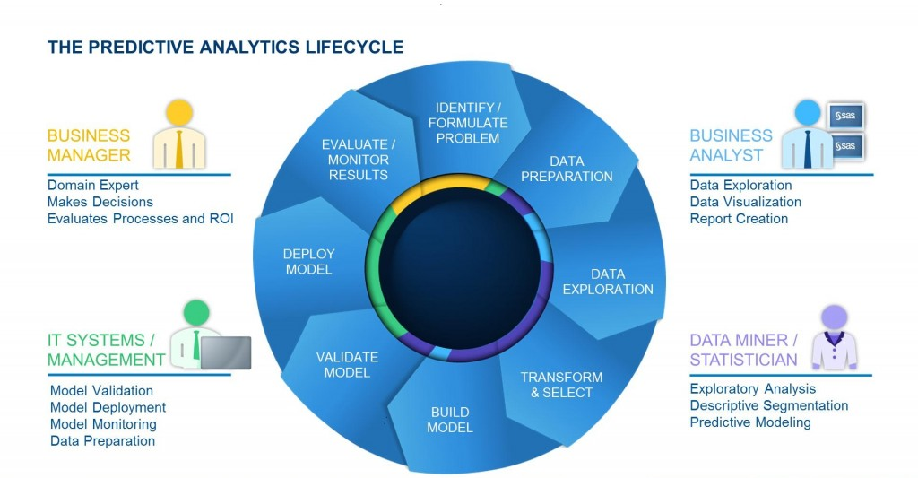
SAS Predictive Analytics Lifecycle

Slide 10
SEMMA Data Mining Model
Sample. The process starts with data sampling, e.g., selecting the data set for modeling. The data set should be large enough to contain sufficient information to retrieve, yet small enough to be used efficiently. This phase also deals with data partitioning.
Explore. This phase covers the understanding of the data by discovering anticipated and unanticipated relationships between the variables, and also abnormalities, with the help of data visualization.
Modify. The Modify phase contains methods to select, create and transform variables in preparation for data modeling.
Model. In the Model phase the focus is on applying various modeling (data mining) techniques on the prepared variables in order to create models that possibly provide the desired outcome.
Assess. The last phase is Assess. The evaluation of the modeling results shows the reliability and usefulness of the created models.
Source: SAS Enterprise Miner website
Source: SAS Enterprise Miner help

Slide 11
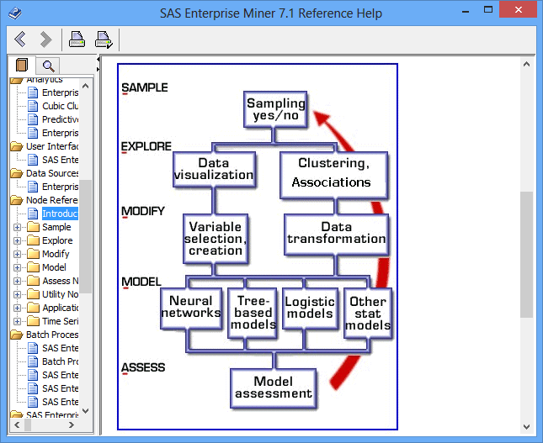
SAS SEMMA Process for Data Mining
Source: SAS Enterprise Miner help

Slide 12
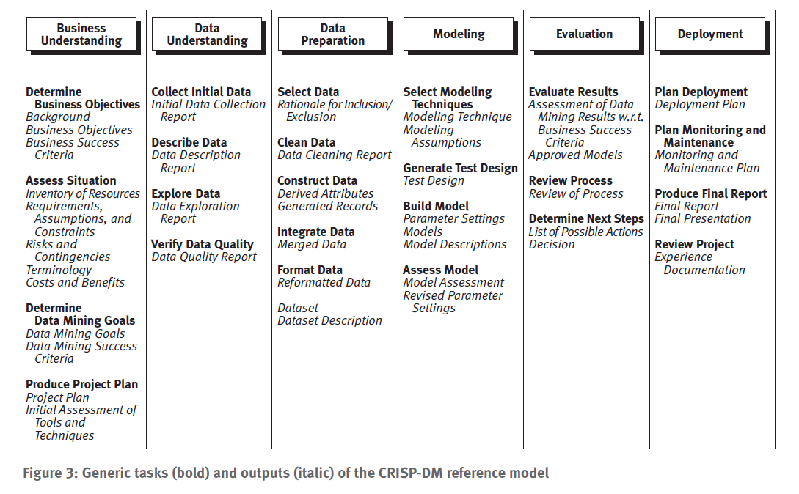
CRISP-DM Data Mining Model
Source: CRISP-DM 1.0 Guide from SPSS.com. Also see www.crisp-dm.org

Slide 13
Foundational Principles for Applied Data Mining
People
  Soft Skills to transform clients to support analytics
Data
  Quality and understanding
Simplicity
  Create the simplest solution to solve the problem well
  “Don’t let perfect be the enemy of good”
  Complexity is harder to explain, deploy, and support

Slide 14
People Issues in Data Mining
Following SEMMA/CRISP-DM gives structure, but does not address all people issues for a DM project
  Does management want the analysis?
  Who will champion the project?
  Who understands the business problem?
  Who understands the data?
  Who will use the results and how can the results be deployed to them?
  What is the background of people on the project?
  How to communicate results to clients?
  Video…

Slide 15
People - Resources for Soft Skills
That ‘70s Show Video – Career Day
Data-informed.com
  “Why Soft Skills Matter in Data Science” Article
SAS
  “Why people and process matter, in addition to great technology, in predictive analytics”
Analytics Magazine
  Soft skills: The ‘killer app’ for analytics

Slide 16
Data Mining: Confluence of Multiple Disciplines
Machine
Learning
Pattern
Recognition
Statistics
Applications
Data Mining
Visualization
Algorithm
Database
Technology
High-Performance
Computing

Slide 17
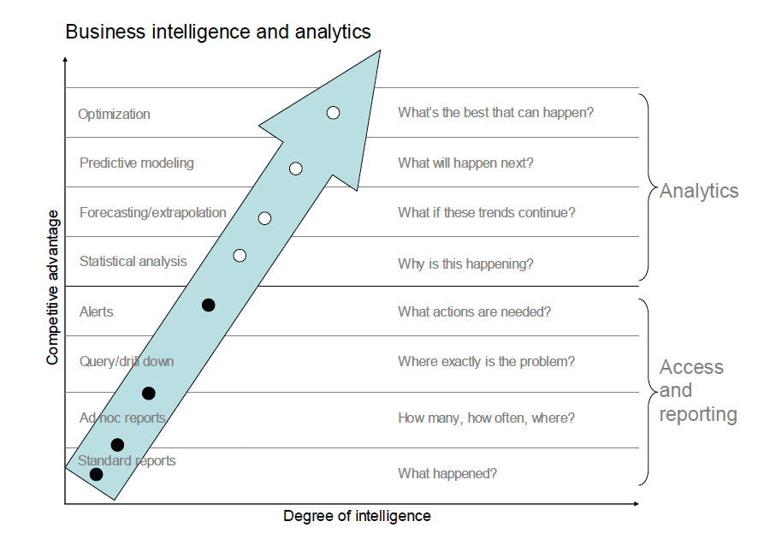
Business Intelligence and Analytics
From “Competing on Analytics” by Davenport and Harris, 2007 and http://contentperspective.se/

Slide 18
Why Not Traditional Data Analysis?
Tremendous amount of data
  Algorithms must be highly scalable to handle such as tera-bytes of data
High-dimensionality of data
  Micro-array may have tens of thousands of dimensions
High complexity of data
  Data streams and sensor data
  Time-series data, temporal data, sequence data
  Structure data, graphs, social networks and multi-linked data
  Heterogeneous databases and legacy databases
  Spatial, spatiotemporal, multimedia, text and Web data
  Software programs, scientific simulations
New and sophisticated applications

Slide 19
Multi-Dimensional View of Data Mining
Data to be mined
  Relational, data warehouse, transactional, stream, object-oriented/relational, active, spatial, time-series, text, multi-media, heterogeneous, legacy, WWW
Knowledge to be mined
  Characterization, discrimination, association, classification, clustering, trend/deviation, outlier analysis, etc.
  Multiple/integrated functions and mining at multiple levels
Techniques utilized
  Database-oriented, data warehouse (OLAP), machine learning, statistics, visualization, etc.
Applications adapted
  Retail, telecommunication, banking, fraud analysis, bio-data mining, stock market analysis, text mining, Web mining, etc.

Slide 20
Data Mining: On What Kinds of Data?
Database-oriented data sets and applications
  Relational database, data warehouse, transactional database
Advanced data sets and advanced applications
  Data streams and sensor data
  Time-series data, temporal data, sequence data (incl. bio-sequences)
  Structure data, graphs, social networks and multi-linked data
  Object-relational databases
  Heterogeneous databases and legacy databases
  Spatial data and spatiotemporal data
  Multimedia database
  Text databases
  The World-Wide Web

Slide 21
ISE 365/465 Coverage (Chapters 1-4, 6, 8-10)
ISE 365/465 Coverage
  Introduction
  Data Preprocessing
  Data Warehouse and OLAP Technology: An Introduction
  Classification and Prediction
  Mining Frequent Patterns, Association and Correlations
  Cluster Analysis
  Real-world application of the above
  Demos, assignments, and projects SAS Enterprise Guide and Enterprise Miner Software

Slide 22
Where to Find References? DBLP, CiteSeer, Google
Data mining and KDD (SIGKDD: CDROM)
  Conferences: ACM-SIGKDD, IEEE-ICDM, SIAM-DM, PKDD, PAKDD, etc.
  Journal: Data Mining and Knowledge Discovery, KDD Explorations, ACM TKDD
Database systems (SIGMOD: ACM SIGMOD Anthology—CD ROM)
  Conferences: ACM-SIGMOD, ACM-PODS, VLDB, IEEE-ICDE, EDBT, ICDT, DASFAA
  Journals: IEEE-TKDE, ACM-TODS/TOIS, JIIS, J. ACM, VLDB J., Info. Sys., etc.
AI & Machine Learning
  Conferences: Machine learning (ML), AAAI, IJCAI, COLT (Learning Theory), CVPR, NIPS, etc.
  Journals: Machine Learning, Artificial Intelligence, Knowledge and Information Systems, IEEE-PAMI, etc.
Web and IR
  Conferences: SIGIR, WWW, CIKM, etc.
  Journals: WWW: Internet and Web Information Systems,
Statistics
  Conferences: Joint Stat. Meeting, etc.
  Journals: Annals of statistics, etc.
Visualization
  Conference proceedings: CHI, ACM-SIGGraph, etc.
  Journals: IEEE Trans. visualization and computer graphics, etc.

Slide 23
Data Mining Software
Enterprise Data Mining Software (for a Cost)
  SAS Enterprise Guide and Enterprise Miner
    We will use these in this course
  IBM SPSS Modeler
  Several Others
Open Source Data Mining Software (Free)
  R (Rattle GUI available for non-coders)
  KNIME
  RapidMiner
  Weka

Slide 24
Introduction Summary
Data mining: Discovering interesting patterns from large amounts of data
A natural evolution of database technology, in great demand, with wide applications
CRISP-DM and SEMMA processes provide roadmap for a data mining project
3 foundational principles of data mining:
  People
  Data
  Simplicity
Mining can be performed in a variety of information repositories
Data mining functionalities: characterization, discrimination, association, classification, clustering, outlier and trend analysis, etc.

Slide 25
Chapter 4.1-2: Data Warehousing and On-line Analytical Processing
Data Warehouse: Basic Concepts
Data Warehouse Modeling: Data Cube and OLAP

Slide 26
What is a Data Warehouse?
Defined in many different ways, but not rigorously.
  A decision support database that is maintained separately from the organization’s operational database
  Support information processing by providing a solid platform of consolidated, historical data for analysis.
“A data warehouse is a subject-oriented, integrated, time-variant, and nonvolatile collection of data in support of management’s decision-making process.”—W. H. Inmon
Data warehousing:
  The process of constructing and using data warehouses

Slide 27
Data Warehouse—Subject-Oriented
Organized around major subjects, such as customer, product, sales
Focusing on the modeling and analysis of data for decision makers, not on daily operations or transaction processing
Provide a simple and concise view around particular subject issues by excluding data that are not useful in the decision support process

Slide 28
Data Warehouse—Integrated
Constructed by integrating multiple, heterogeneous data sources
  relational databases, flat files, on-line transaction records
Data cleaning and data integration techniques are applied.
  Ensure consistency in naming conventions, encoding structures, attribute measures, etc. among different data sources
    E.g., Hotel price: currency, tax, breakfast covered, etc.
  When data is moved to the warehouse, it is converted.

Slide 29
Data Warehouse—Time Variant
The time horizon for the data warehouse is significantly longer than that of operational systems
  Operational database: current value data
  Data warehouse data: provide information from a historical perspective (e.g., past 5-10 years)
Every key structure in the data warehouse
  Contains an element of time, explicitly or implicitly
  But the key of operational data may or may not contain “time element”

Slide 30
Data Warehouse—Nonvolatile
A physically separate store of data transformed from the operational environment
Operational update of data does not occur in the data warehouse environment
  Does not require transaction processing, recovery, and concurrency control mechanisms
  Requires only two operations in data accessing:
    initial loading of data and access of data

Slide 31
Why a Separate Data Warehouse?
High performance for both systems
  DBMS— tuned for OLTP: access methods, indexing, concurrency control, recovery
  Warehouse—tuned for OLAP: complex OLAP queries, multidimensional view, consolidation
Different functions and different data:
  missing data: Decision support requires historical data which operational DBs do not typically maintain
  data consolidation: DS requires consolidation (aggregation, summarization) of data from heterogeneous sources
  data quality: different sources typically use inconsistent data representations, codes and formats which have to be reconciled
Note: There are more and more systems which perform OLAP analysis directly on relational databases

Slide 32
Data Warehouse: A Multi-Tiered Architecture
Monitor
&
Integrator
OLAP Server
Other
sources
Metadata
Analysis
Query
Reports
Data mining
Operational
DBs
Extract
Transform
Load
Refresh
Data
Warehouse
Serve
Data Marts
Data Sources
OLAP Engine
Data Storage
Front-End Tools

Slide 33
Three Data Warehouse Models
Enterprise warehouse
  collects all of the information about subjects spanning the entire organization
Data Mart
  a subset of corporate-wide data that is of value to a specific groups of users. Its scope is confined to specific, selected groups, such as marketing data mart
    Independent vs. dependent (directly from warehouse) data mart
Virtual warehouse
  A set of views over operational databases
  Only some of the possible summary views may be materialized

Slide 34
Extraction, Transformation, and Loading (ETL)
Data extraction
  get data from multiple, heterogeneous, and external sources
Data cleaning
  detect errors in the data and rectify them when possible
Data transformation
  convert data from legacy or host format to warehouse format
Load
  sort, summarize, consolidate, compute views, check integrity, and build indicies and partitions
Refresh
  propagate the updates from the data sources to the warehouse

Slide 35
Metadata Repository
Meta data is the data defining warehouse objects. It stores:
Description of the structure of the data warehouse
  schema, view, dimensions, hierarchies, derived data defn, data mart locations and contents
Operational meta-data
  data lineage (history of migrated data and transformation path), currency of data (active, archived, or purged), monitoring information (warehouse usage statistics, error reports, audit trails)
The algorithms used for summarization
The mapping from operational environment to the data warehouse
Data related to system performance
  warehouse schema, view and derived data definitions
Business data
  business terms and definitions, ownership of data, charging policies

Slide 36
Chapter 4.1-2: Data Warehousing and On-line Analytical Processing
Data Warehouse: Basic Concepts
Data Warehouse Modeling: Data Cube and OLAP

Slide 37
From Tables and Spreadsheets to
Data Cubes
A data warehouse is based on a multidimensional data model which views data in the form of a data cube
A data cube, such as sales, allows data to be modeled and viewed in multiple dimensions
  Dimension tables, such as item (item_name, brand, type), or time(day, week, month, quarter, year)
  Fact table contains measures (such as dollars_sold) and keys to each of the related dimension tables
In data warehousing literature, an n-D base cube is called a base cuboid. The top most 0-D cuboid, which holds the highest-level of summarization, is called the apex cuboid. The lattice of cuboids forms a data cube.

Slide 38
Conceptual Modeling of Data Warehouses
Modeling data warehouses: dimensions & measures
  Star schema: A fact table in the middle connected to a set of dimension tables
  Snowflake schema: A refinement of star schema where some dimensional hierarchy is normalized into a set of smaller dimension tables, forming a shape similar to snowflake
  Fact constellations: Multiple fact tables share dimension tables, viewed as a collection of stars, therefore called galaxy schema or fact constellation

Slide 39
Example of Star Schema
time
time_key
day
day_of_the_week
month
quarter
year
item
item_key
item_name
brand
type
supplier_type
Sales Fact Table
time_key
item_key
branch_key
branch
location
location_key
branch_key
branch_name
branch_type
location_key
street
city
state_or_province
country
units_sold
dollars_sold
avg_sales
Measures

Slide 40
Example of Snowflake Schema
time
item
time_key
day
day_of_the_week
month
quarter
year
item_key
item_name
brand
type
supplier_key
supplier
Sales Fact Table
supplier_key
supplier_type
time_key
item_key
branch_key
branch
location
location_key
location_key
street
city_key
branch_key
branch_name
branch_type
units_sold
dollars_sold
city
city_key
city
state_or_province
country
avg_sales
Measures

Slide 41
Example of Fact Constellation
time
time_key
day
day_of_the_week
month
quarter
year
item
Shipping Fact Table
item_key
item_name
brand
type
supplier_type
Sales Fact Table
time_key
time_key
item_key
shipper_key
item_key
branch_key
from_location
branch
location_key
location
to_location
branch_key
branch_name
branch_type
units_sold
location_key
street
city
province_or_state
country
dollars_cost
dollars_sold
units_shipped
avg_sales
shipper
Measures
shipper_key
shipper_name
location_key
shipper_type

Slide 42
A Concept Hierarchy:
Dimension (location)
all
all
region
Europe
...
North_America
country
Germany
...
Spain
Canada
...
Mexico
city
Frankfurt
...
Vancouver
...
Toronto
office
L. Chan
...
M. Wind

Slide 43

A Sample Data Cube
Date
Total annual sales
of TVs in U.S.A.
1Qtr
2Qtr
3Qtr
4Qtr
sum
Product
TV
PC
U.S.A
VCR
sum
Canada
Country
Mexico
sum
All, All, All

Slide 44
Typical OLAP Operations
Roll up (drill-up): summarize data
  by climbing up hierarchy or by dimension reduction
Drill down (roll down): reverse of roll-up
  from higher level summary to lower level summary or detailed data, or introducing new dimensions
Slice and dice: project and select
Pivot (rotate):
  reorient the cube, visualization, 3D to series of 2D planes
Other operations
  drill across: involving (across) more than one fact table
  drill through: through the bottom level of the cube to its back-end relational tables (using SQL)

Slide 45

Fig. 3.10 Typical OLAP Operations

Slide 46

Browsing a Data Cube
Visualization
OLAP capabilities
Interactive manipulation

